Slide 1
Problem Characteristics in AI

Slide 2
Problem Characteristics in AI
Since artificial intelligence (AI) is mainly related to the search process, it is important to have some methodology to choose the best possible solution.
To choose an appropriate method for a particular problem first we need to categorize the problem based on the following characteristics.
  Is the problem decomposable into small sub-problems which are easy to solve?
  Can solution steps be ignored or undone?
  Is the universe of the problem is predictable?
  Is a good solution to the problem is absolute or relative?
  Is the solution to the problem a state or a path?
  What is the role of knowledge in solving a problem using artificial intelligence?
  Does the task of solving a problem require human interaction?

Slide 3
Problem solving is a process of generating solutions from observed data.
• A ‘problem’ is characterized by a set of goals,
• A set of objects, and
• A set of operations.

Slide 4
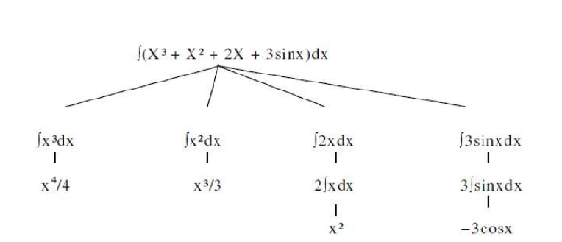
Is the problem decomposable into small sub-problems which are easy to solve?
Suppose to solve the expression is: + ∫(X³ + X² + 2X + 3sinx) dx
This problem can be solved by breaking it into smaller problems, each of which we can solve by using a small collection of specific rules.
Using this technique of problem decomposition, we can solve very large problems very easily.
This can be considered as an intelligent behavior.

Slide 5
Can solution steps be ignored or undone?
Ignorable problems can be solved using a simple control structure that never backtracks.
Recoverable problems can be solved using backtracking.
Irrecoverable problems can be solved by recoverable style methods via planning.
In the Theorem Proving problem, a lemma that has been proved can be ignored for the next steps.
Such problems are called Ignorable problems.
Consider the 8-puzzle problem to solve: we make a wrong move and realize that mistake. But here, the control strategy must keep track of all the moves, so that we can backtrack to the initial state and start with some new move.
Such problems are called Recoverable problems.
In Playing Chess, moves can be retracted.
Such problems are called Irrecoverable problems.

Slide 6
Is the Problem Universe Predictable?
In Playing Bridge, We cannot know exactly where all the cards are or what the other players will do on their turns.
  Uncertain outcome!
For certain-outcome problems, planning can be used to generate a sequence of operators that is guaranteed to lead to a solution.
For uncertain-outcome problems, a sequence of generated operators can only have a good probability of leading to a solution. Plan revision is made as the plan is carried out and the necessary feedback is provided.

Slide 7
Is Good Solution Absolute or Relative?
Consider the problem of answering questions based on a database of simple facts such as the following:
  Siva was a man.
  Siva was a worker in a company.
  Siva was born in 1905.
  All men are mortal.
  All workers in a factory died when there was an accident in 1952.
  No mortal lives longer than 100 years.
Suppose we ask a question: ‘Is Siva alive?’

Slide 8
By representing these facts in a formal language, such as predicate logic, and then using formal inference methods we can derive an answer to this question easily.
There are two ways to answer the question shown below:
Method I:
  Siva was a man.
  Siva was born in 1905.
  All men are mortal.
  Now it is 2028, so Siva’s age is 103 years.
  No mortal lives longer than 100 years.
Method II:
  Siva is a worker in the company.
  All workers in the company died in 1952.
Answer: So Siva is not alive. It is the answer from the above methods.
We are interested to answer the question; it does not matter which path we follow. If we follow one path successfully to the correct answer, then there is no reason to go back and check another path to lead the solution.

Slide 9
Is the solution to the problem a state or a path
A path-solution problem can be reformulated as a state-solution problem by describing a state as a partial path to a solution. The question is whether that is natural or not.
What is the role of knowledge in solving a problem using artificial intelligence?
Knowledge is required even to be able to recognize a solution.
  Reading Newspaper
    Now consider the problem of scanning daily newspapers to decide which are supporting the Democrats and which are supporting the Republicans in some upcoming election. Again assuming unlimited computing power, how much knowledge would be required by a computer trying to solve this problem? This time the answer is a great deal.
    It would have to know such things as:
    The names of the candidates in each party.
    The fact that if the major thing you want to see done is have taxes lowered, you are probably supporting the Republicans.
    The fact that if the major thing you want to see done is improved education for minority students, you are probably supporting the Democrats.
    The fact that if you are opposed to big government, you are probably supporting the Republicans.

Slide 10
Does the task of solving a problem require human interaction?
Sometimes it is useful to program computers to solve problems in ways that the majority of people would not be able to understand.
This is fine if the level of the interaction between the computer and its human users is problem-in solution-out.
But increasingly we are building programs that require intermediate interaction with people, both to provide additional input to the program and to provide additional reassurance to the user.
  The solitary problem, in which there is no intermediate communication and no demand for an explanation of the reasoning process.
  The conversational problem, in which intermediate communication is to provide either additional assistance to the computer or additional information to the user.

Slide 11
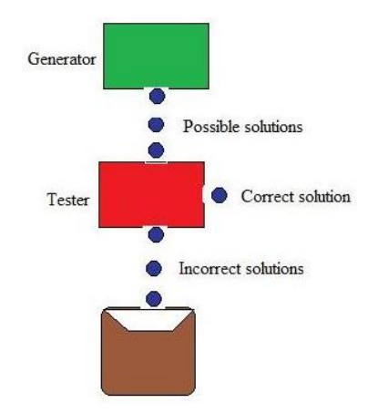
Generate and Test search algorithm
Generate-and-test search algorithm is a very simple algorithm that guarantees to find a solution if done systematically and there exists a solution.
Algorithm: Generate-And-Test
Generate a possible solution.
Test to see if this is the expected solution.
If the solution has been found quit else go to step 1.
Potential solutions that need to be generated vary depending on the kinds of problems. For some problems the possible solutions may be particular points in the problem space and for some problems, paths from the start state

Slide 12
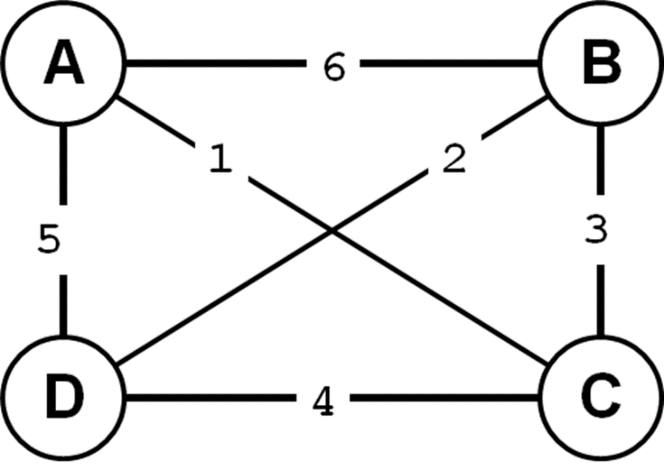
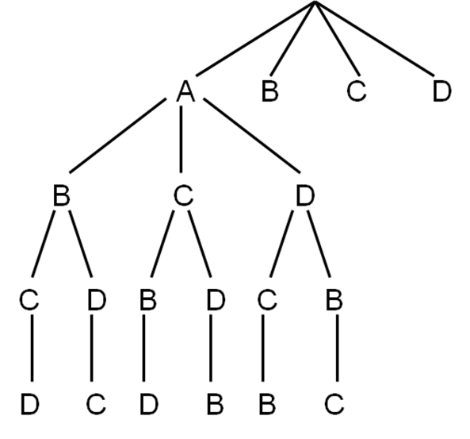
Example – Traveling Salesman Problem (TSP)
A salesman has a list of cities, each of which he must visit exactly once. There are direct roads between each pair of cities on the list. Find the route the salesman should follow for the shortest possible round trip that both starts and finishes at any one of the cities.
  Traveler needs to visit n cities.
  Know the distance between each pair of cities.
  Want to know the shortest route that visits all the cities once.
Search flow with Generate and Test
Finally, select the path whose length is less.

Slide 13
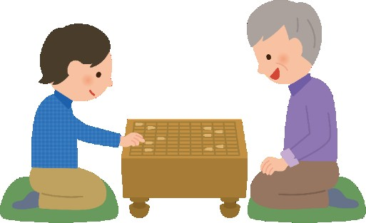
What are heuristics?
Heuristics are know-hows obtained
through a lot of experiences.
Heuristics often enable us (or animals) to act quickly without thinking deeply about the reasons or without thinking at all.
In many cases, heuristics are “tacit knowledge”
that cannot be explained verbally.
The more experiences we have, the more and the better the heuristics will be.

Slide 14
Definitions
Heuristics (Greek heuriskein = find, discover): "the study of the methods and rules of discovery and invention".
We use our knowledge of the problem to consider some (not all) successors of the current state (preferably just one, as with an oracle). This means pruning the state space, gaining speed, but perhaps missing the solution!
In chess: consider one (apparently best) move, maybe a few -- but not all possible legal moves.
In the travelling salesman problem: select one nearest city, give up complete search (the greedy technique). This gives us, in polynomial time, an approximate solution of the inherently exponential problem; it can be proven that the approximation error is bounded.

Slide 15
Definitions (2)
For heuristic search to work, we must be able to rank the children of a node. A heuristic function takes a state and returns a numeric value -- a composite assessment of this state. We then choose a child with the best score (this could be a maximum or minimum).
A heuristic function can help gain or lose a lot, but finding the right function is not always easy.
The 8-puzzle: how many misplaced tiles? how many slots away from the correct place? and so on.
Water jugs: ???
Chess: no simple counting of pieces is adequate.

Slide 16
Definitions (3)
The principal gain -- often spectacular -- is the reduction of the state space. For example, the full tree for Tic-Tac-Toe has 9! leaves. If we consider symmetries, the tree becomes six times smaller, but it is still quite large.
With a fairly simple heuristic function we can get the tree down to 40 states. (More on this when we discuss games.)
Heuristics can also help speed up exhaustive, blind search, such as depth-first and breadth-first search.

Slide 17
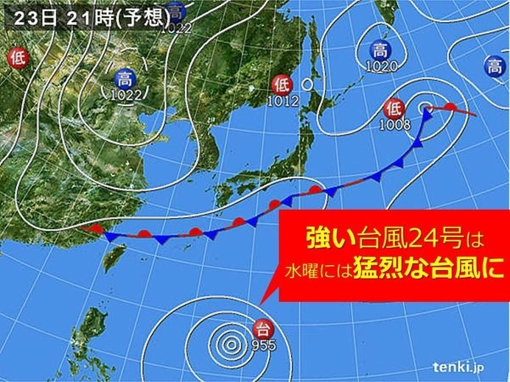
Why heuristic search?
Based on the heuristics, we can get good solutions without investigating all possible cases.
In fact, a deep learner is used in Alpha-Go to learn heuristics for playing Go-game, and this learner can help the system to make decisions efficiently.
Without using heuristics, many AI-related problems cannot be solved (may take many years to get a solution).
Patterns memorized so far can be used by a prediction model to make a hypothesis about the move of the typhon.

Slide 18
Hill climbing
Define the current state as an initial state
Loop until the goal state is achieved or no more operators can be applied on the current state:
  Apply an operation to current state and get a new state
  Compare the new state with the goal
  Quit if the goal state is achieved
  Evaluate new state with heuristic function and compare it with the current state
  If the newer state is closer to the goal compared to current state, update the current state
This is a greedy algorithm: go as high up as possible as fast as possible, without looking around too much.
The algorithm
select a heuristic function;
set C, the current node, to the highest-valued initial node;
loop
  select N, the highest-valued child of C;
  return C if its value is better than the value of N;
  otherwise set C to N;

Slide 19
Problems with hill climbing
Local maximum, or the foothill problem: there is a peak, but it is lower than the highest peak in the whole space.
The plateau problem: all local moves are equally unpromising, and all peaks seem far away.
The ridge problem: almost every move takes us down.
Random-restart hill climbing is a series of hill-climbing searches with a randomly selected start node whenever the current search gets stuck.
See also simulated annealing -- in a moment.

Slide 20
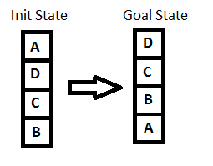
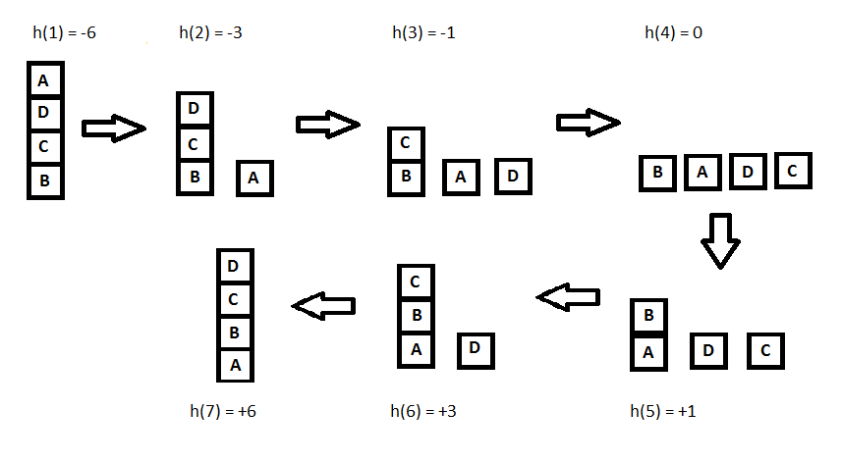
Example
Let's define such function h:
h(x) = +1 for all the blocks in the support structure if the block is correctly positioned otherwise -1 for all the blocks in the support structure.

Slide 21
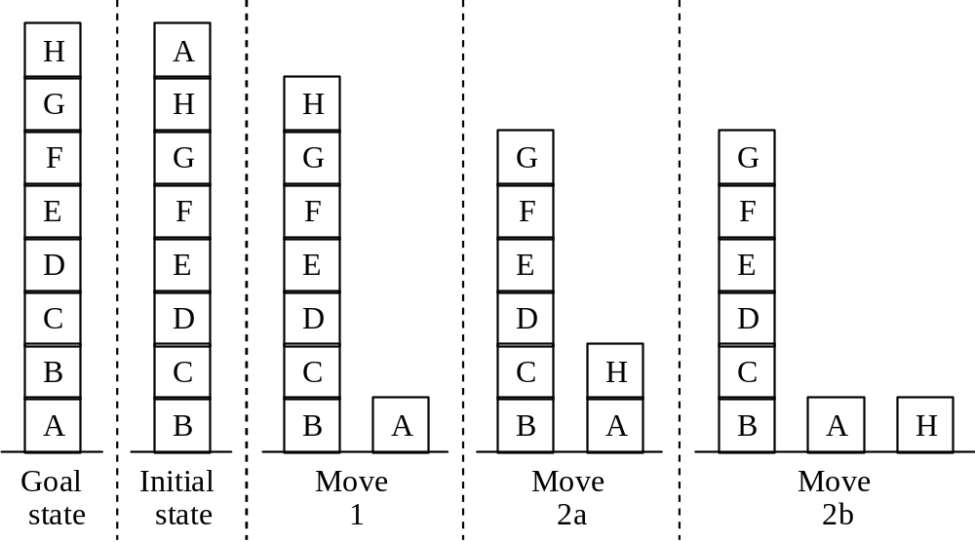
A hill climbing example

Slide 22
A hill climbing example (2)
A local heuristic function
Count +1 for every block that sits on the correct thing. The goal state has the value +8.
Count -1 for every block that sits on an incorrect thing. In the initial state blocks C, D, E, F, G, H count +1 each. Blocks A, B count -1 each , for the total of +4.
Move 1 gives the value +6 (A is now on the correct support). Moves 2a and 2b both give +4 (B and H are wrongly situated). This means we have a local maximum of +6.

Slide 23
A hill climbing example (4)
Move 1 gives the value -21 (A is now on the correct support).
Move 2a gives -16, because C, D, E, F, G, H
count -1, -2, -3, -4, -5, -1.
Move 2b gives -15, because C, D, E, F, G
count -1, -2, -3, -4, -5.
There is no local maximum!
Moral: sometimes changing the heuristic function is all we need.

Slide 24
Best First Search Algorithm
Create 2 empty lists: OPEN and CLOSED
Start from the initial node (say N) and put it in the ‘ordered’ OPEN list
Repeat the next steps until the GOAL node is reached
  If the OPEN list is empty, then EXIT the loop returning ‘False’
  Select the first/top node (say N) in the OPEN list and move it to the CLOSED list. Also, capture the information of the parent node
  If N is a GOAL node, then move the node to the Closed list and exit the loop returning ‘True’. The solution can be found by backtracking the path
  If N is not the GOAL node, expand node N to generate the ‘immediate’ next nodes linked to node N and add all those to the OPEN list
  Reorder the nodes in the OPEN list in ascending order according to an evaluation function f(n)
This algorithm will traverse the shortest path first in the queue. The time complexity of the algorithm is given by O(n*logn).

Slide 25
Best-first search
The algorithm
select a heuristic function (e.g., distance to the goal);
put the initial node(s) on the open list;
repeat
  select N, the best node on the open list;
  succeed if N is a goal node; otherwise put N on the closed list and add N's children to the open list;
until
  we succeed or the open list becomes empty (we fail);
A closed node reached on a different path is made open.
NOTE: "the best" only means "currently appearing the best"...

Slide 26
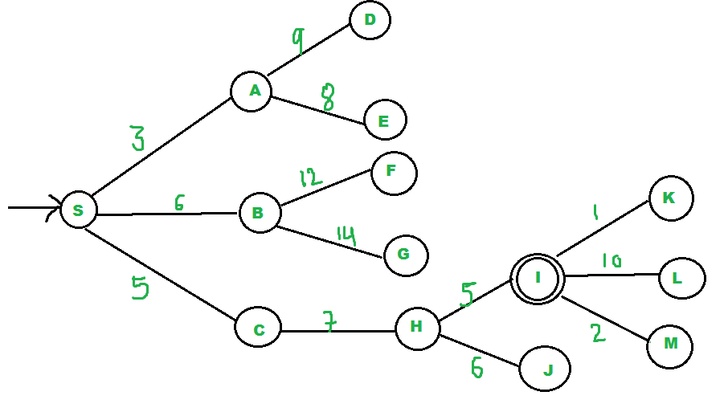
BFS uses the concept of a Priority queue and heuristic search. To search the graph space, the BFS method uses two lists for tracking the traversal. An ‘Open’ list that keeps track of the current ‘immediate’ nodes available for traversal and a ‘CLOSED’ list that keeps track of the nodes already traversed.
We start from source “S” and search for goal “I” using given costs and Best First search.
pq initially contains S
  We remove s from and process unvisited neighbors of S to pq.
  pq now contains {A, C, B} (C is put before B because C has lesser cost)
We remove A from pq and process unvisited neighbors of A to pq.
  pq now contains {C, B, E, D}
We remove C from pq and process unvisited neighbors of C to pq.
  pq now contains {B, H, E, D}
We remove B from pq and process unvisited neighbors of B to pq.
  pq now contains {H, E, D, F, G}
We remove H from pq.
Since our goal “I” is a neighbor of H, we return.

Slide 27
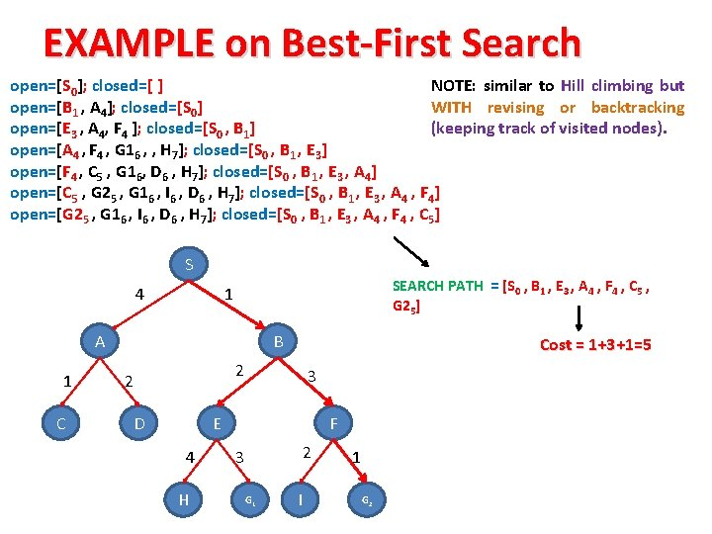

Slide 28
Beam Search
Beam search is a heuristic search algorithm that explores a graph by expanding the most optimistic node in a limited set. Beam search is an optimization of best-first search that reduces its memory requirements.
Beam search, only a predetermined number of best partial solutions are kept as candidates. Therefore, it is a greedy algorithm.
Beam search uses breadth-first search to build its search tree. At each level of the tree, it generates all successors of the states at the current level, sorting them in increasing order of heuristic cost.

Slide 29
Beam Search
The heuristic cost associated with the node is used to choose the best nodes. The width of the beam search is denoted by W. If B is the branching factor, at every depth, there will always be W × B nodes under consideration, but only W will be chosen.
More states are trimmed when the beam width is reduced.
When W = 1, the search becomes a hill-climbing search in which the best node is always chosen from the successor nodes

Slide 30
Beam Search
Is heuristic approach where only the most promising ß nodes (instead of all nodes) at each step of the search are retained for further branching.
ß is called Beam Width.
Beam search is an optimization of best-first search that reduces its memory requirements.
Notes:
Diff btwn local beam search and beam search

Slide 31
Beam Search Algorithm
OPEN = {initial state}
while OPEN is not empty do
1. Remove the best node from OPEN, call it n.
2. If n is the goal state, backtrace path to n (through recorded parents) and return path.
3. Create n's successors.
4. Evaluate each successor, add it to OPEN, and record its parent.
5. If |OPEN| > ß , take the best ß nodes (according to heuristic) and remove the others from the OPEN.
done
Notes:
The concept of closed list?

Slide 32
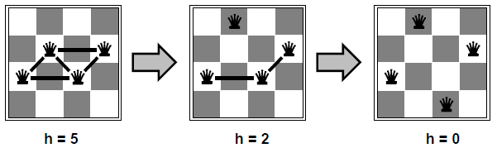
Example of Beam Search
4-queen puzzle
Initially, randomly put queens in each column
h = no. of conflicts
Let ß = 1,and proceed as given below

Slide 33
Simulated Annealing
Simulated annealing is a stochastic global search algorithm for function optimization.
It makes use of randomness as part of the search process. This makes the algorithm appropriate for nonlinear objective functions where other local search algorithms do not operate well.
Like the stochastic hill climbing local search algorithm, it modifies a single solution and searches the relatively local area of the search space until the local optima is located.
Unlike the hill climbing algorithm, it may accept worse solutions as the current working solution.
The simulated annealing optimization algorithm can be thought of as a modified version of stochastic hill climbing.

Slide 34

Stochastic hill climbing maintains a single candidate solution and takes steps of a random but constrained size from the candidate in the search space. If the new point is better than the current point, then the current point is replaced with the new point. This process continues for a fixed number of iterations.
Simulated annealing executes the search in the same way. The main difference is that new points that are not as good as the current point (worse points) are accepted sometimes.
A worse point is accepted probabilistically where the likelihood of accepting a solution worse than the current solution is a function of the temperature of the search and how much worse the solution is than the current solution.

Slide 35
Differences with hill climbing
The annealing scheduling must be maintained
Moves to worse states may be accepted
It is good idea to maintain, in addition to the current state, the best state found so far. Then, if the final state is worse than the earlier state (because of bad luck in accepting moves to worse state) the earlier state is still available.

Slide 36
Advantages
Easy to implement and use
Provides optimal solutions to a wide range of problems
Disadvantages
Can take a long time to run if the annealing schedule is very long
There are a lot of tuneable parameters in this algorithm
Let’s now try to draw parallel’s between Annealing in metallurgy and Simulated annealing for Feature selection:
In terms of feature selection,
Set of features represents the arrangement of molecules in the material(metal).
No. of Iterations represents time. Therefore, as the no. of iterations decreases temperature decreases.
Change in Predictive performance between the previous and the current iteration represents the change in material’s energy.

Slide 37
Algorithm:
Let’s go over the exact Simulated Annealing algorithm, step-by-step.
The initial step is to select a subset of features at random.
Then choose the no. of iterations. A ML model is then built and the predictive performance (otherwise called objective function) is calculated.
A small percentage of features are randomly included/excluded from the model. This is just to ‘perturb’ the features. Then the predictive performance is calculated once again for this new set of features.
Two things can happen here:
If performance Increases in the new set then the new feature set is Accepted.
If the performance of the new feature set has worse performance, then the Acceptance Probability (otherwise called metropolis acceptance criterion) is calculated. (You will see the formula and its significance shortly. Stay with the flow for now.)

Slide 38
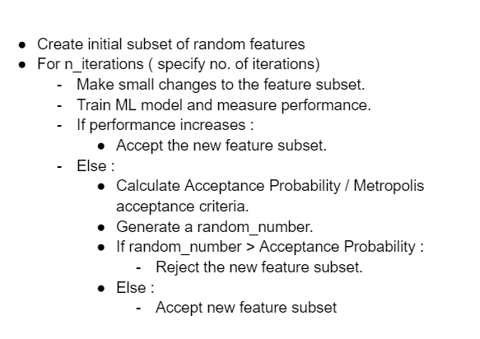
Once the acceptance probability is calculated, generate a random number between 0 – 1
If the Random Number > Acceptance Probability then the new feature set is Rejected and the previous feature set will be continued to be used.
If the Random Number < Acceptance Probability then the new feature set is Accepted.
The impact of randomness by this process helps simulated annealing to not get stuck at local optimums in search of a global optimum.
Keep doing this for the chosen number of iterations.

